Slide 1
UbiComp Demo

Slide 2
Problem
Dehydration in the workplace
Targeted at mainly office workers
Alerts the user when they need to drink

Slide 3
[Video here]

Slide 4
Data Processing
Data stored in a CSV file
Accessed when optimising real time alerts
Accessed when graphing
Data shows user's drinking habits over a day
How much did they drink?
When did they drink?
Used for
Real time alerts
Optimising real time alerts
Showing user their drinking behaviour

Slide 5
IMAGE OF GRAPH
INSERT AN IMAGE OF THE GRAPH

Slide 6
Feedback and Output
User receives alerts on their phone
Does not disrupt daily life with visual or audio clutter
Easy to see
What other options could be used
Buzzer/LED
Where not used as they are too invasive (not acceptable by the user)

Slide 7
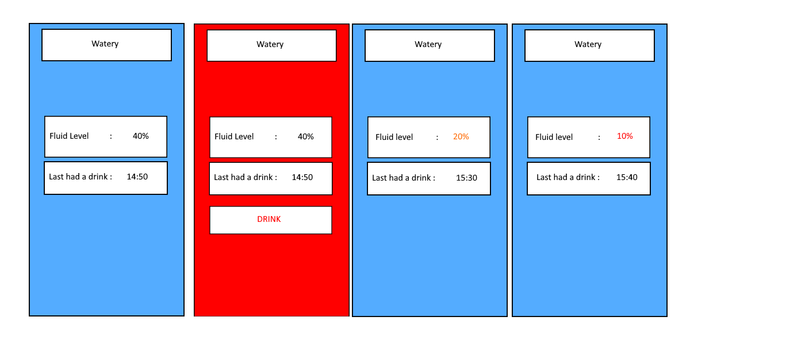
App
When the user needs to drink the app changes colour to make it obvious to the user
The app shows the fluid level of the container and the last time they had a drink
When the fluid level reaches a certain point, it changes colour to show that its getting low.

